Slide 1

CS 533 INTRO TO DATA SCIENCE
Michael Ekstrand

Slide 2
LOG LIKELIHOOD

Slide 3

Learning Outcomes
Compute the log likelihood of data from a model estimating probabilities.
Understand the objective function of logistic regression.
Photo by Devin Avery on Unsplash

Slide 4


Logistic Regression
We learned the model:
$$P\left(Y=1 | X=x\right)=\hat{y}=logistic\left(β_{0}+\sum_{j}{β_{j}x_{j}}\right)$$
The model computes probability of yes.

Slide 5
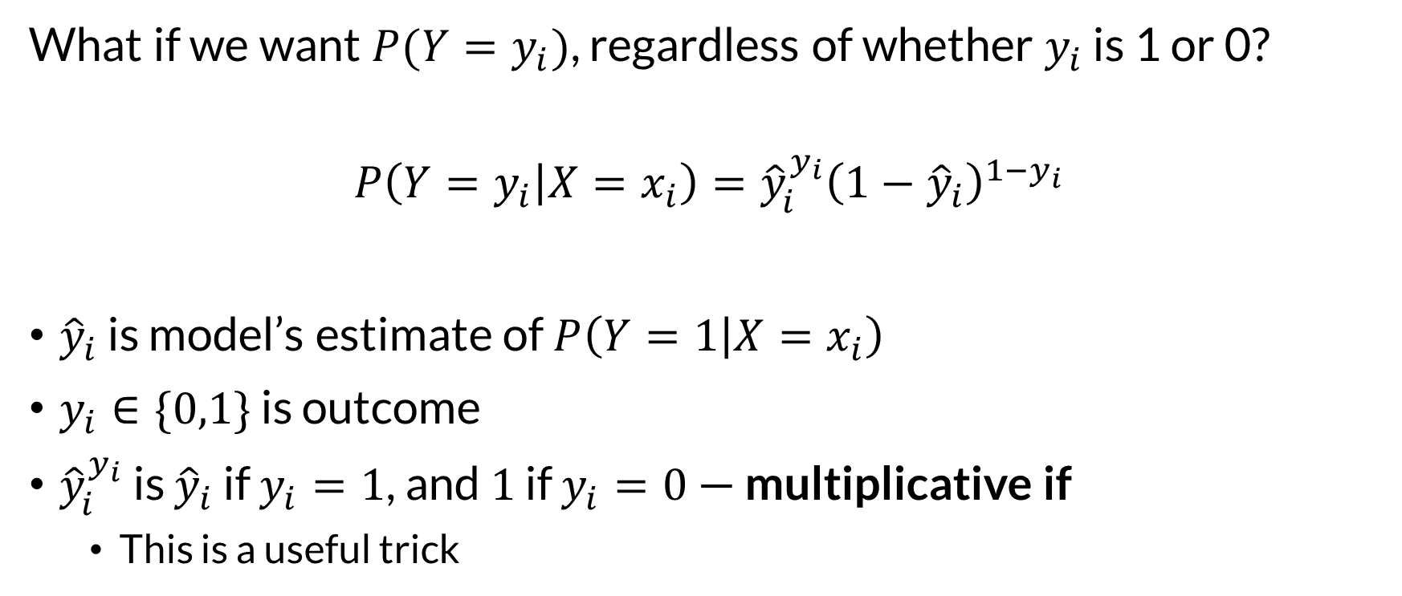
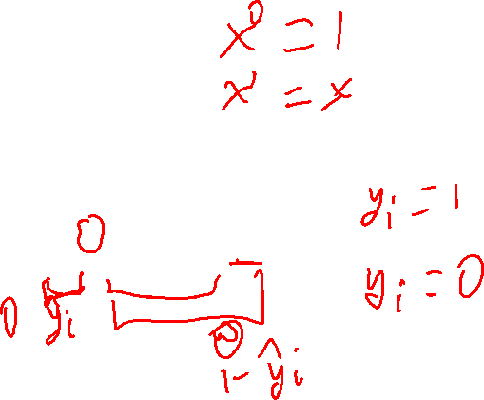
Probability of Observed
What if we want $P(Y=y_{i})$, regardless of whether $y_{i}$ is 1 or 0?
$$P\left(Y=y_{i} | X=x_{i}\right)={\hat{y}}_{i}^{y_{i}}{\left(1−{\hat{y}}_{i}\right)}^{1−y_{i}}$$
${\hat{y}}_{i}$ is model’s estimate of $P\left(Y=1 | X=x_{i}\right)$
$y_{i}∈\{0,1\}$ is outcome
${\hat{y}}_{i}^{y_{i}}$ is ${\hat{y}}_{i}$ if $y_{i}=1$, and $1$ if $y_{i}=0$ — multiplicative if
This is a useful trick

Slide 6
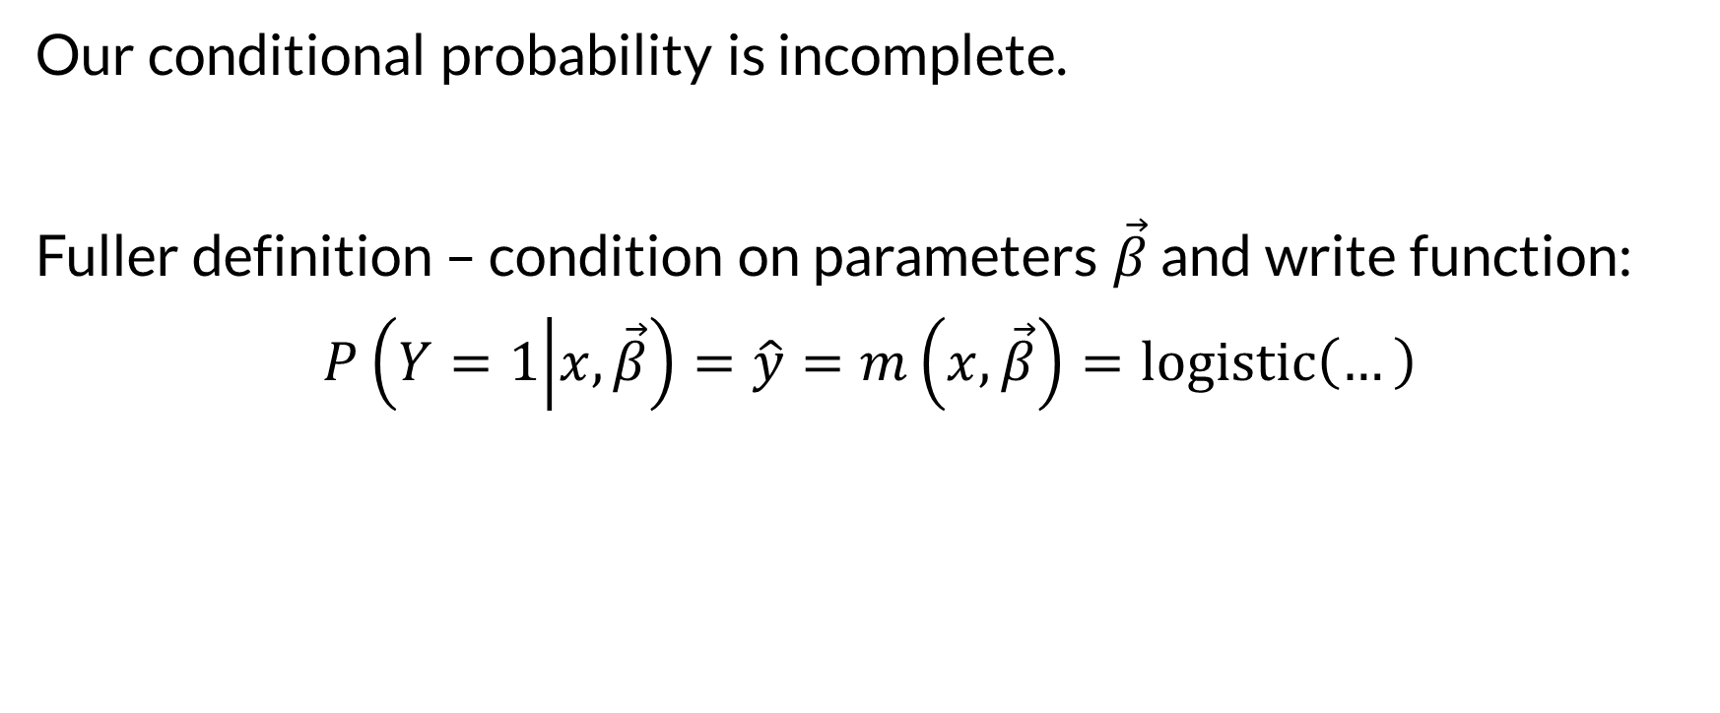

Conditioning on Parameters
Our conditional probability is incomplete.
Fuller definition – condition on parameters $\vec{β}$ and write function:
$$P\left(Y=1 | x,\vec{β}\right)=\hat{y}=m\left(x,\vec{β}\right)=logistic\left(…\right)$$

Slide 7
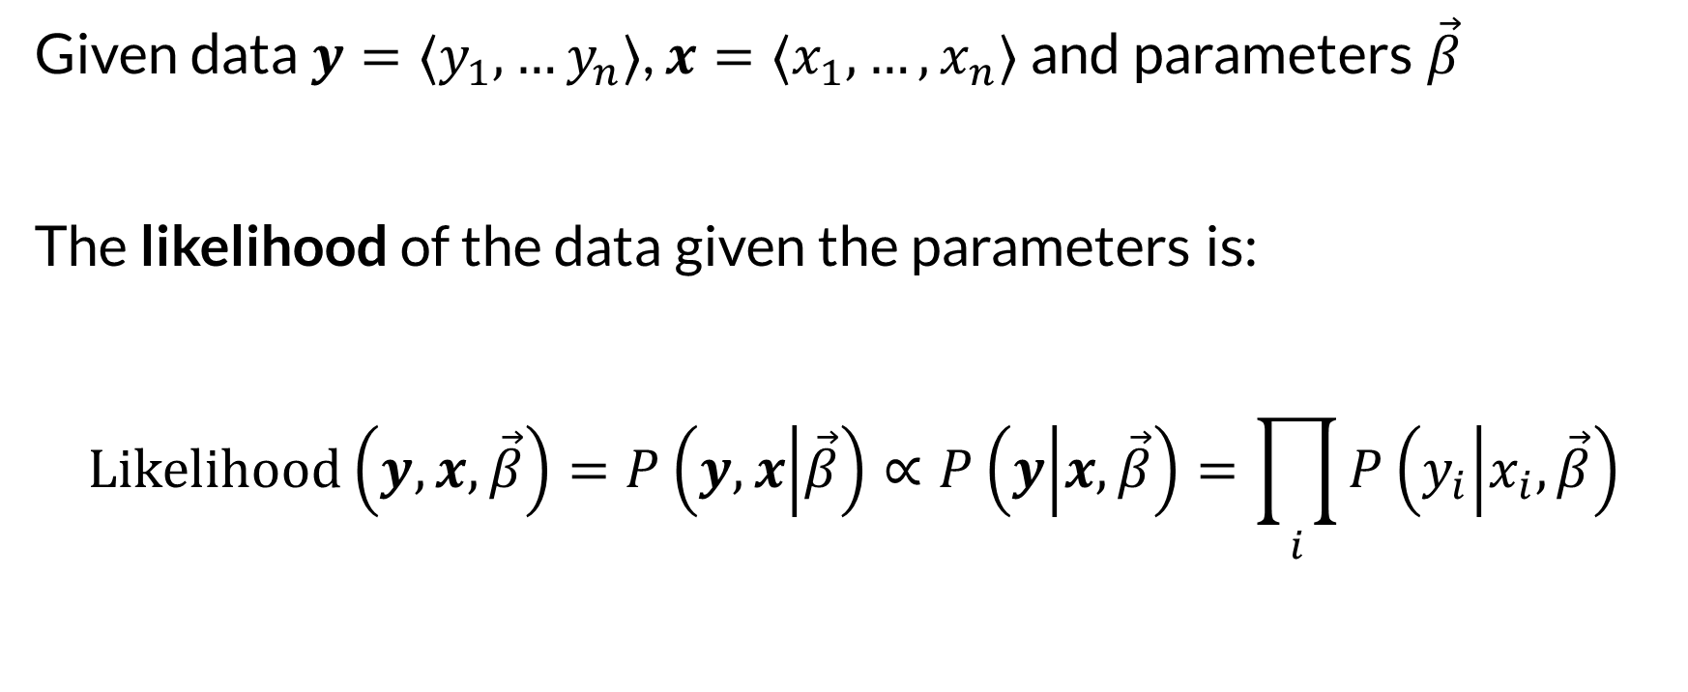

Likelihood Function
Given data $y=⟨y_{1},…y_{n}⟩$, $x=⟨x_{1},…,x_{n}⟩$ and parameters $\vec{β}$
The likelihood of the data given the parameters is:
$$Likelihood\left(y,x,\vec{β}\right)=P\left(y,x | \vec{β}\right)∝P\left(y | x,\vec{β}\right)=\prod_{i}{P\left(y_{i} | x_{i},\vec{β}\right)}$$

Slide 8
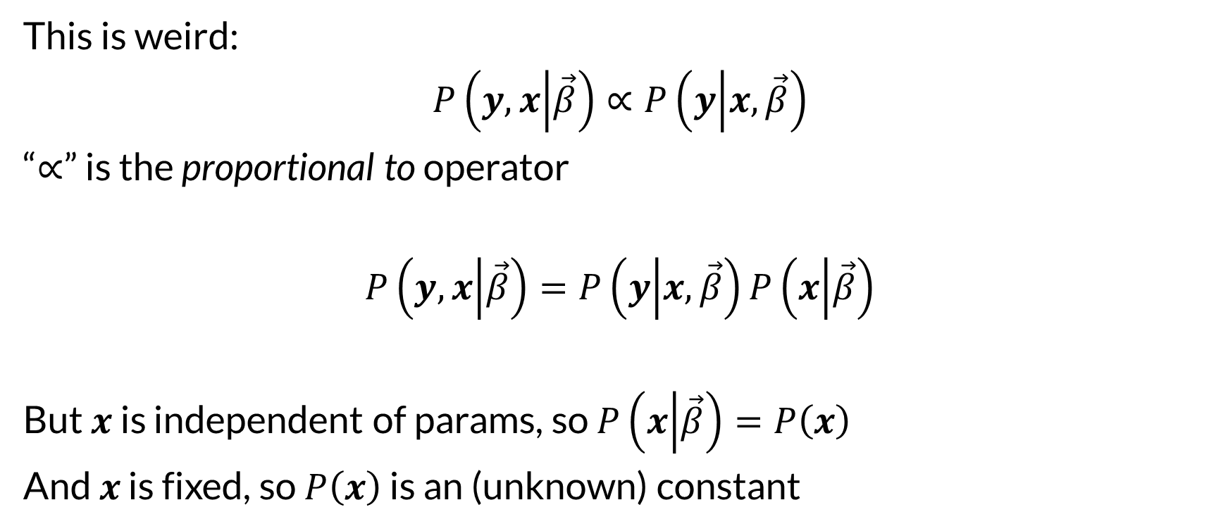

Proportionality
This is weird:
$$P\left(y,x | \vec{β}\right)∝P\left(y | x,\vec{β}\right)$$
“$∝$” is the proportional to operator
$$P\left(y,x | \vec{β}\right)=P\left(y | x,\vec{β}\right)P\left(x | \vec{β}\right)$$
But $x$ is independent of params, so $P\left(x | \vec{β}\right)=P\left(x\right)$
And $x$ is fixed, so $P\left(x\right)$ is an (unknown) constant

Slide 9


Log Likelihood
$$LogLik\left(y,x,\vec{β}\right)=\log{Likelihood\left(y,x,\vec{β}\right)} \\ =\log{P\left(x\right)\prod_{i}{P\left(y_{i} | x_{i},\vec{β}\right)}} \\ =\log{P\left(x\right)}+\sum_{i}{\log{P\left(y_{i} | x_{i},\vec{β}\right)}}$$

Slide 10
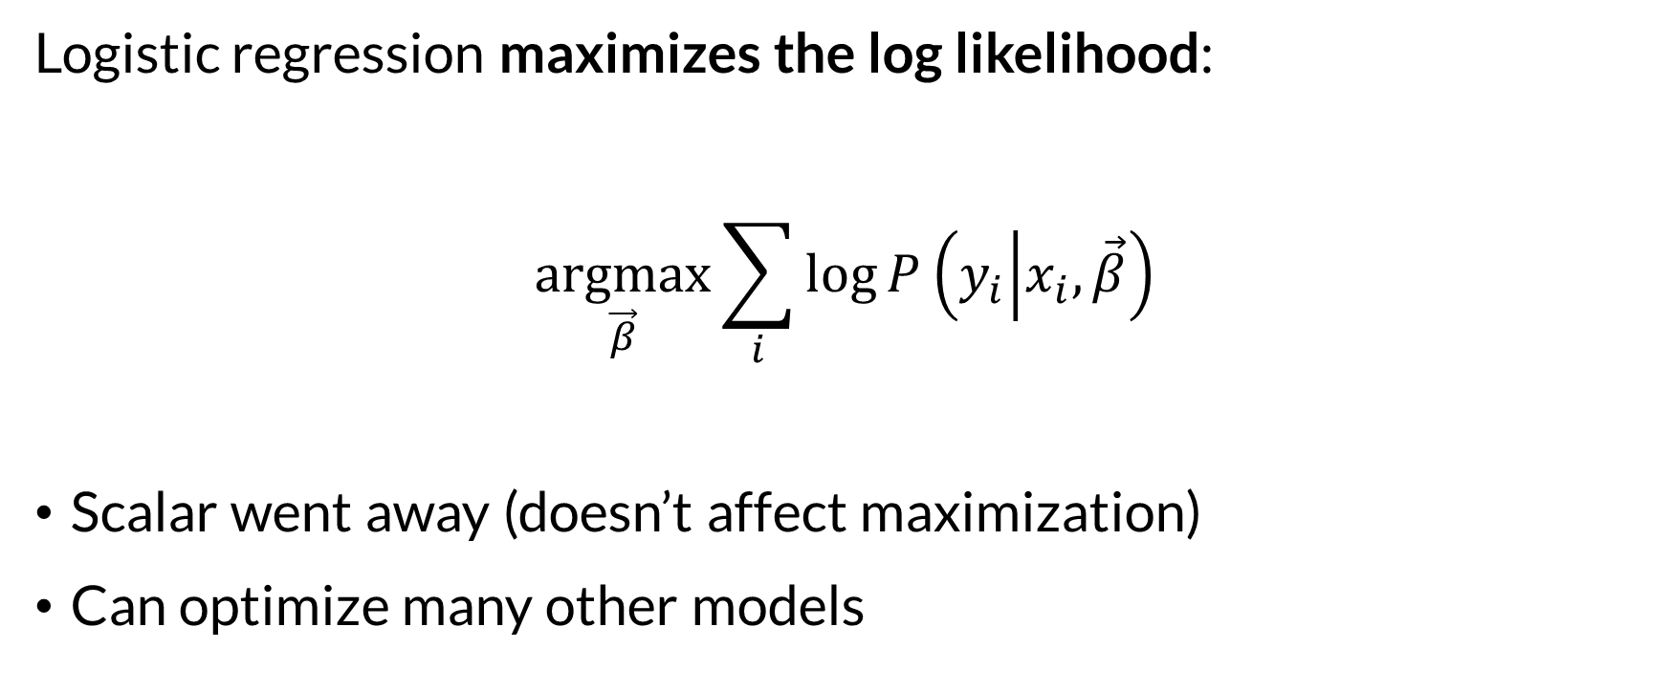
Maximum Likelihood Estimator
Logistic regression maximizes the log likelihood:
$$\underset{\vec{β}}{argmax}{\sum_{i}{\log{P\left(y_{i} | x_{i},\vec{β}\right)}}}$$
Scalar went away (doesn’t affect maximization)
Can optimize many other models

Slide 11
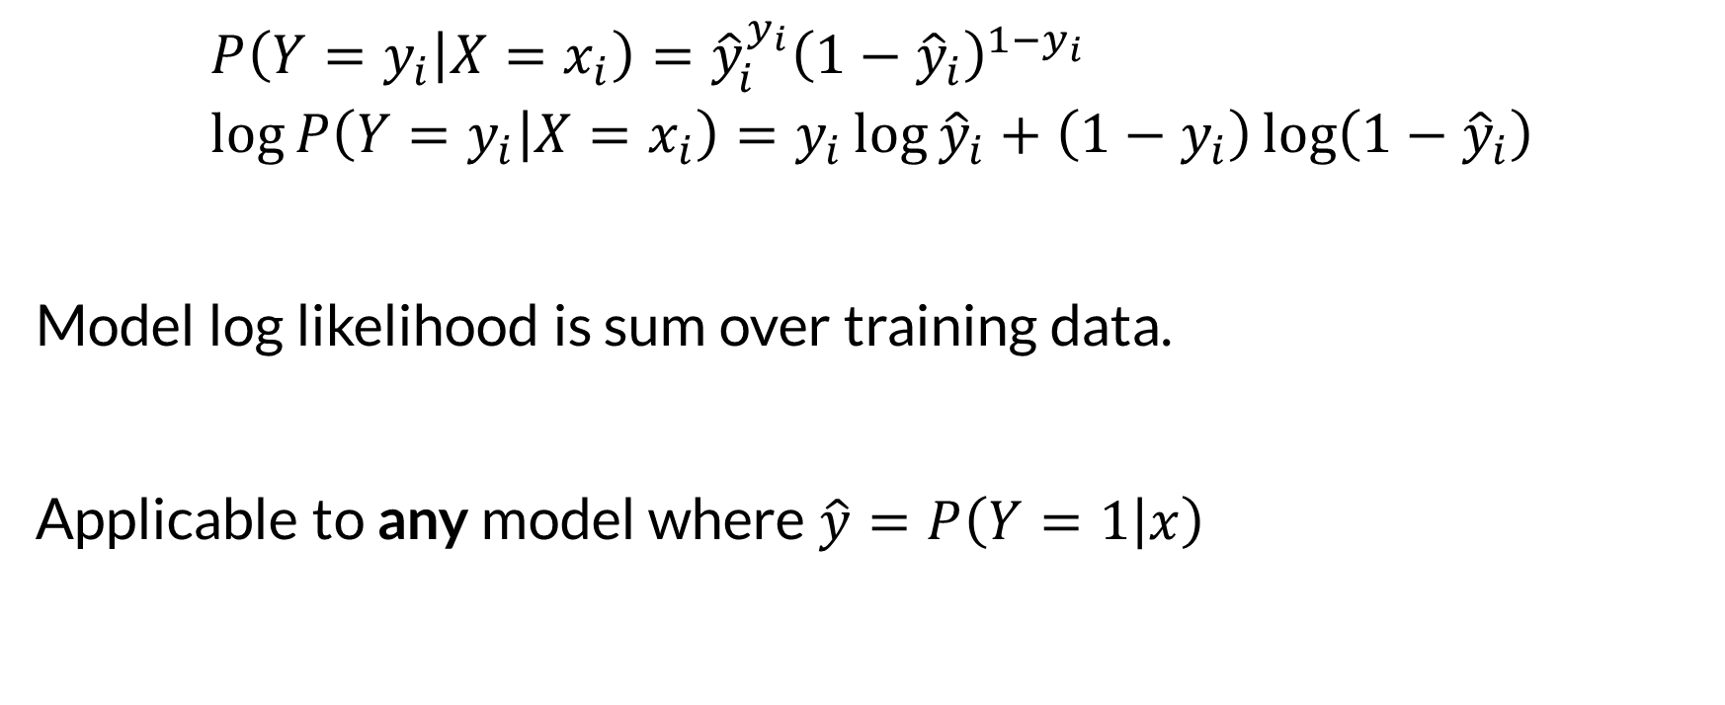
Expanded Log Likelihood
$$P\left(Y=y_{i} | X=x_{i}\right)={\hat{y}}_{i}^{y_{i}}{\left(1−{\hat{y}}_{i}\right)}^{1−y_{i}} \\ \log{P\left(Y=y_{i} | X=x_{i}\right)}=y_{i}\log{{\hat{y}}_{i}}+\left(1−y_{i}\right)\log\left(1−{\hat{y}}_{i}\right)$$
Model log likelihood is sum over training data.
Applicable to any model where $\hat{y}=P\left(Y=1 | x\right)$

Slide 12
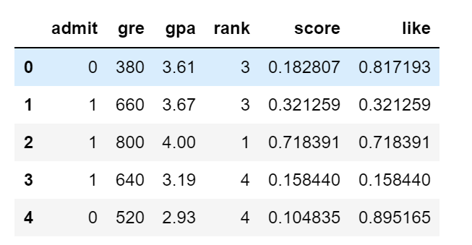
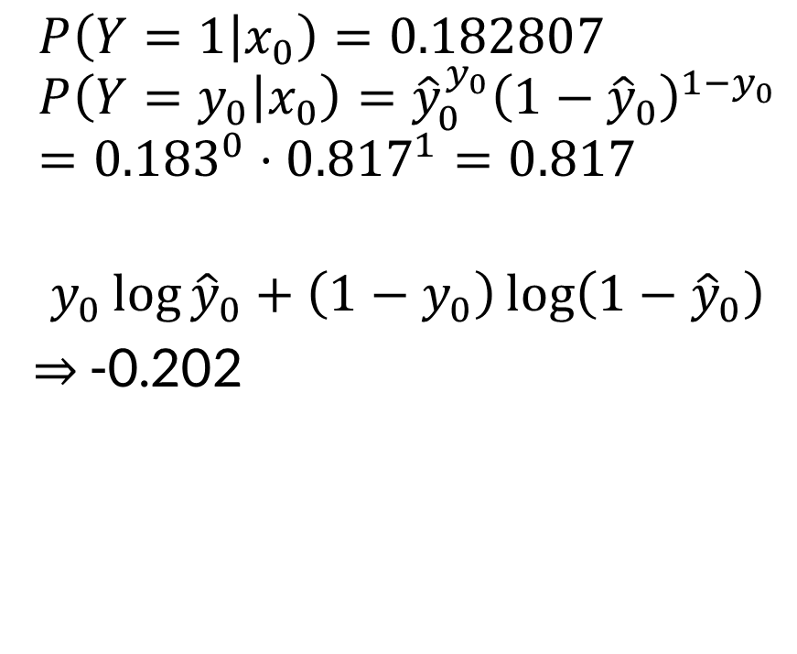
Example
$$P\left(Y=1 | x_{0}\right)=0.182807 \\ P\left(Y=y_{0} | x_{0}\right)={\hat{y}}_{0}^{y_{0}}{\left(1−{\hat{y}}_{0}\right)}^{1−y_{0}} \\ ={0.183}^{0}⋅{0.817}^{1}=0.817$$
$$y_{0}\log{{\hat{y}}_{0}}+\left(1−y_{0}\right)\log\left(1−{\hat{y}}_{0}\right)$$
⇒ -0.202
Can compare on same data
Different data ⇒ different likelihood

Slide 13
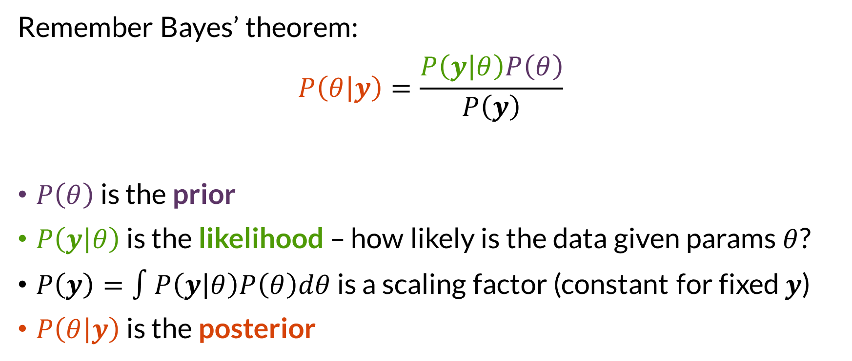

Likelihood and Posterior
Remember Bayes’ theorem:
$$P\left(θ | y\right)=\frac{P\left(y | θ\right)P\left(θ\right)}{P\left(y\right)}$$
$P\left(θ\right)$ is the prior
$P\left(y | θ\right)$ is the likelihood – how likely is the data given params $θ$?
$P\left(y\right)=∫P\left(y | θ\right)P\left(θ\right)dθ$ is a scaling factor (constant for fixed $y$)
$P\left(θ | y\right)$ is the posterior

Slide 14
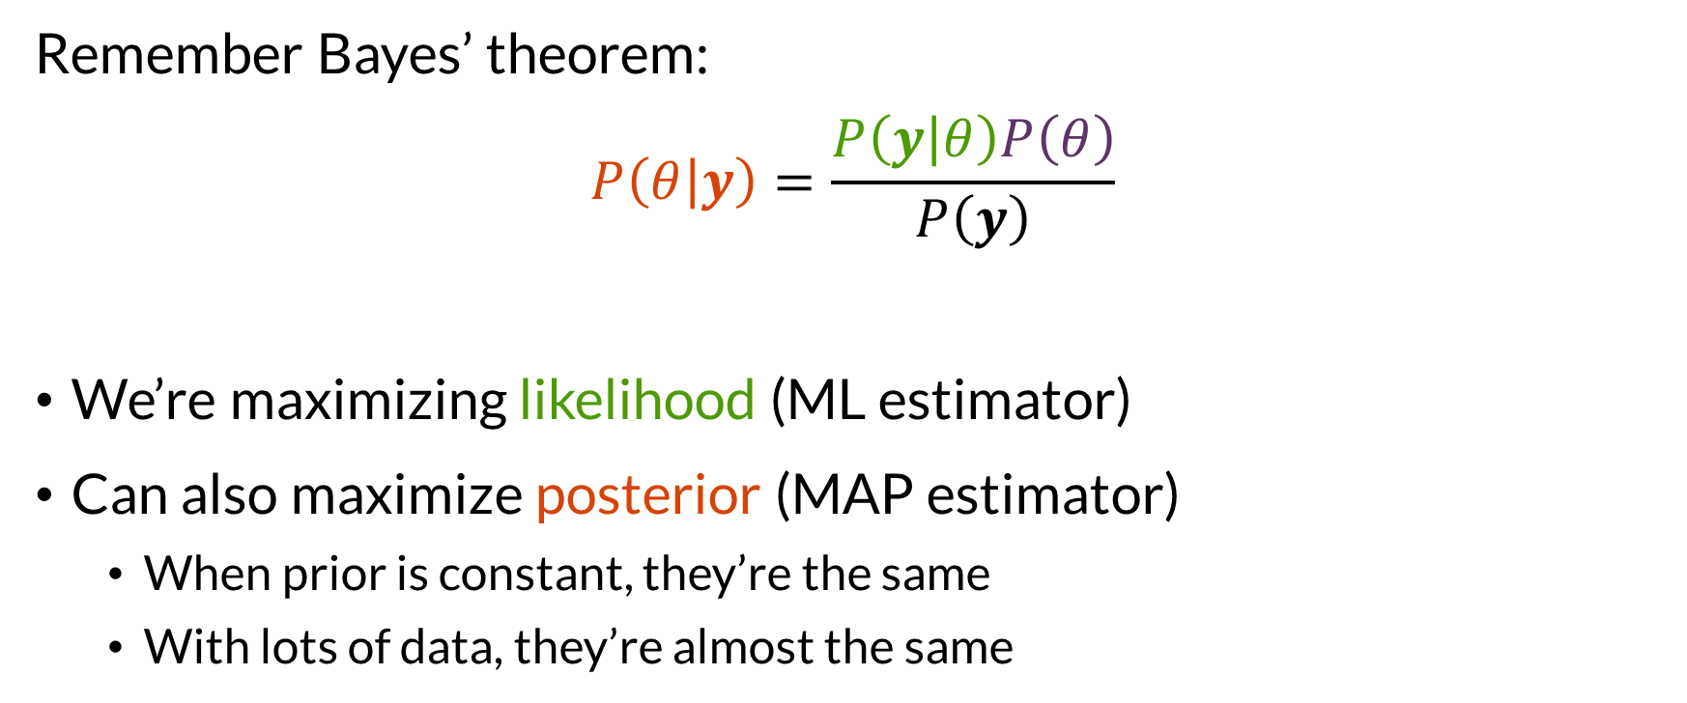

Maximizing
Remember Bayes’ theorem:
$$P\left(θ | y\right)=\frac{P\left(y | θ\right)P\left(θ\right)}{P\left(y\right)}$$
We’re maximizing likelihood (ML estimator)
Can also maximize posterior (MAP estimator)
When prior is constant, they’re the same
With lots of data, they’re almost the same

Slide 15

Wrapping Up
Logistic function is trained by maximizing the log likelihood of the training data given the model.
Photo by Geran de Klerk on Unsplash

